Slide 1
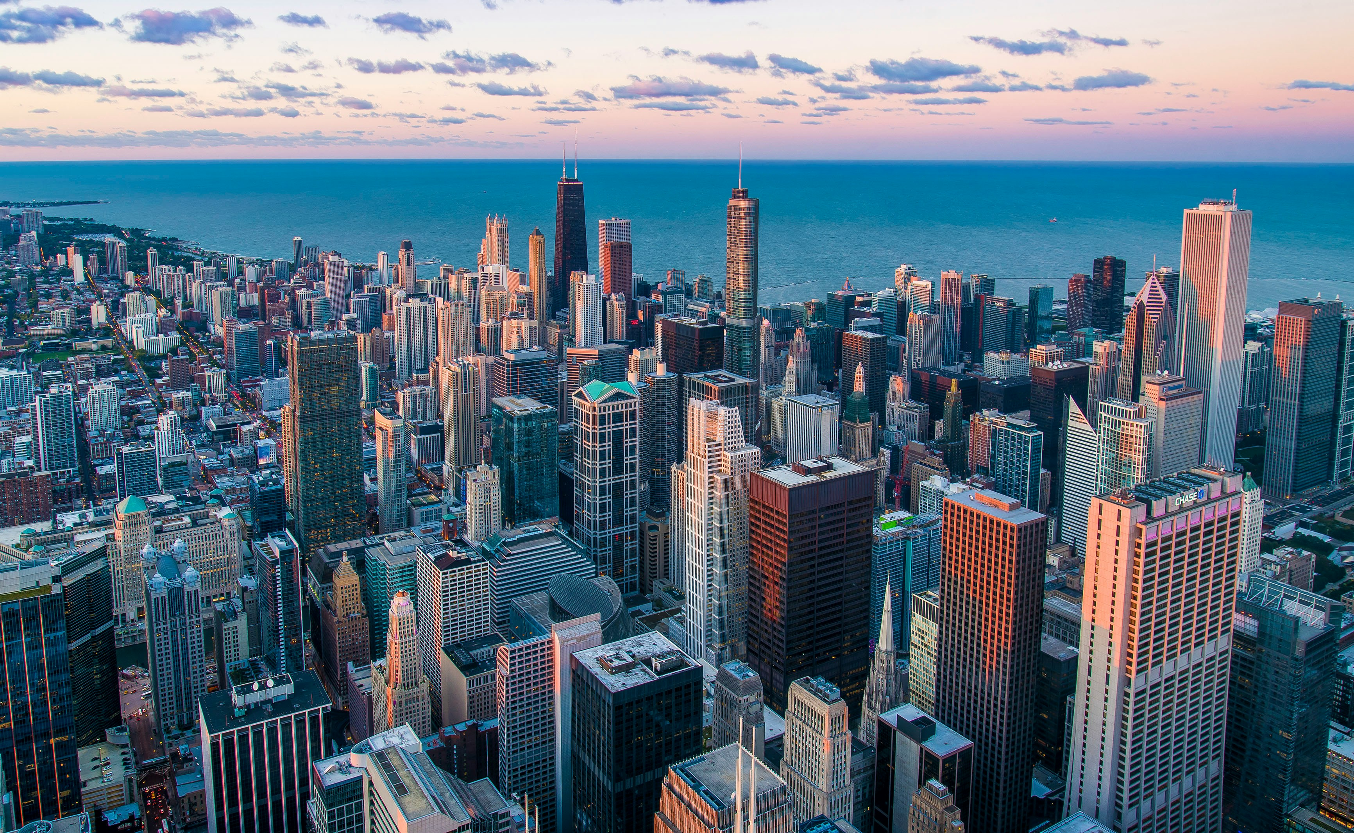
1.目標
Notes:
https://unsplash.com/photos/white-and-brown-city-buildings-during-daytime-Nyvq2juw4_o

Slide 2

2.阻礙
Notes:
https://unsplash.com/photos/gold-glitter-with-jar-4jLj-GdRn_A

Slide 3
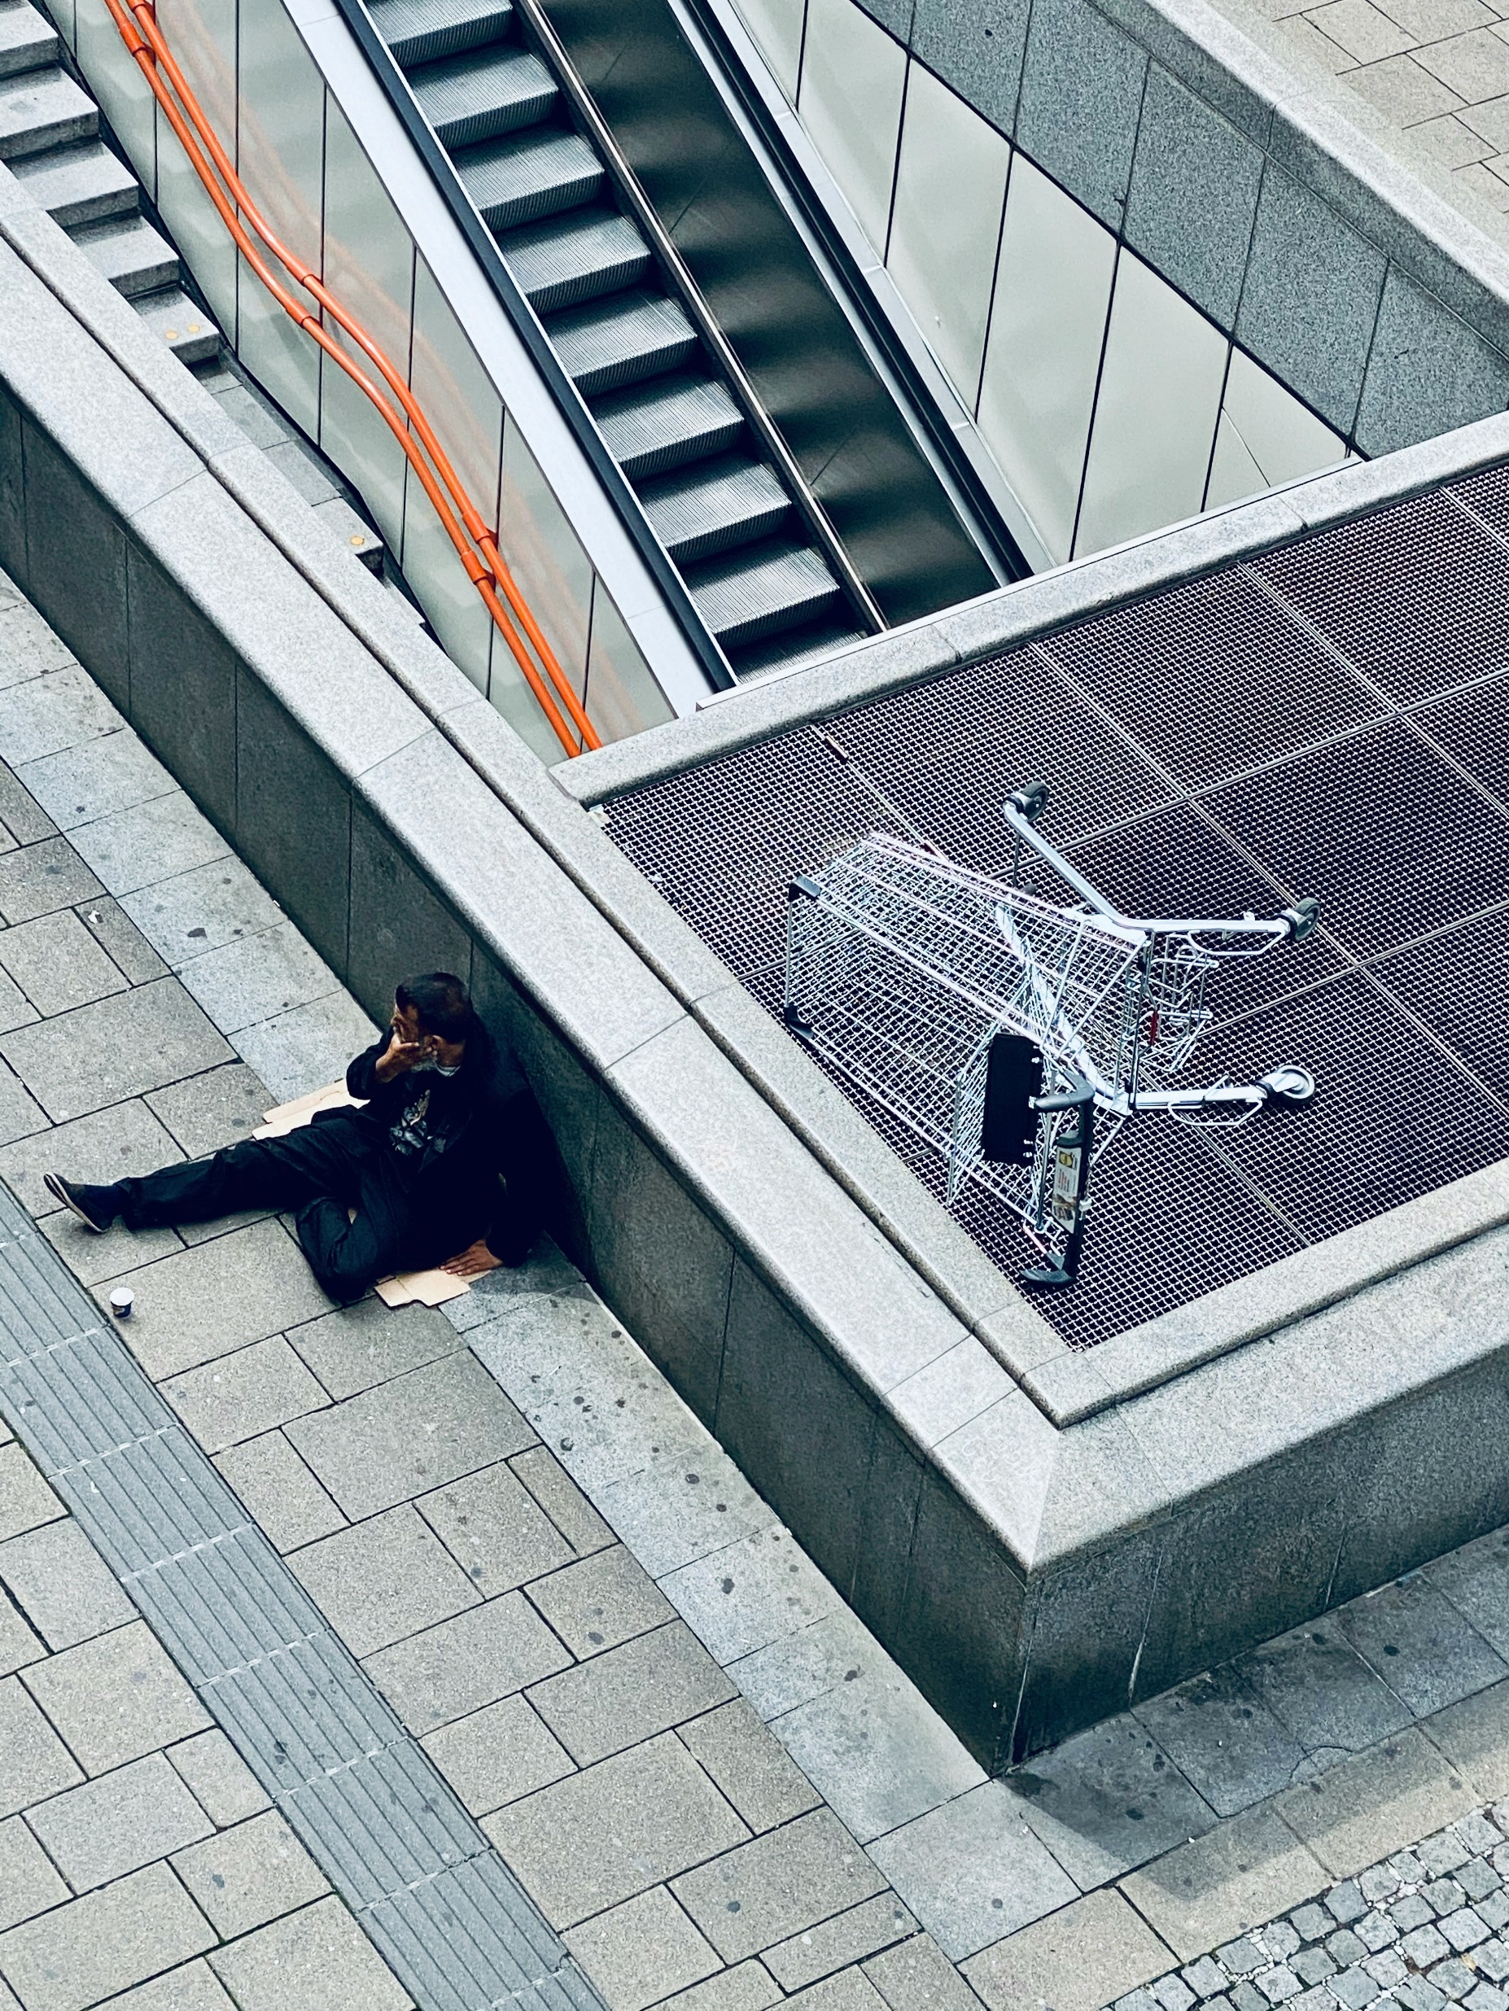
3.努力
Notes:
https://unsplash.com/photos/woman-in-black-jacket-and-black-pants-lying-on-gray-concrete-stairs-OsKtCkfV8zw

Slide 4
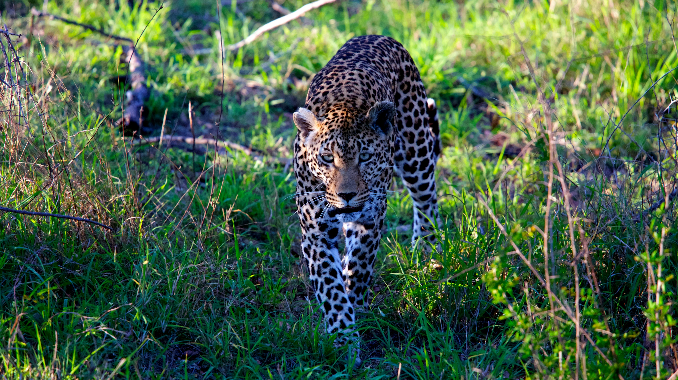
4.結果
Notes:
https://unsplash.com/photos/leopard-walking-on-grass-field-during-daytime-Ow9rMU7Fl2U

Slide 5

5.意外
Notes:
https://unsplash.com/photos/a-group-of-friends-at-a-coffee-shop--uHVRvDr7pg

Slide 6
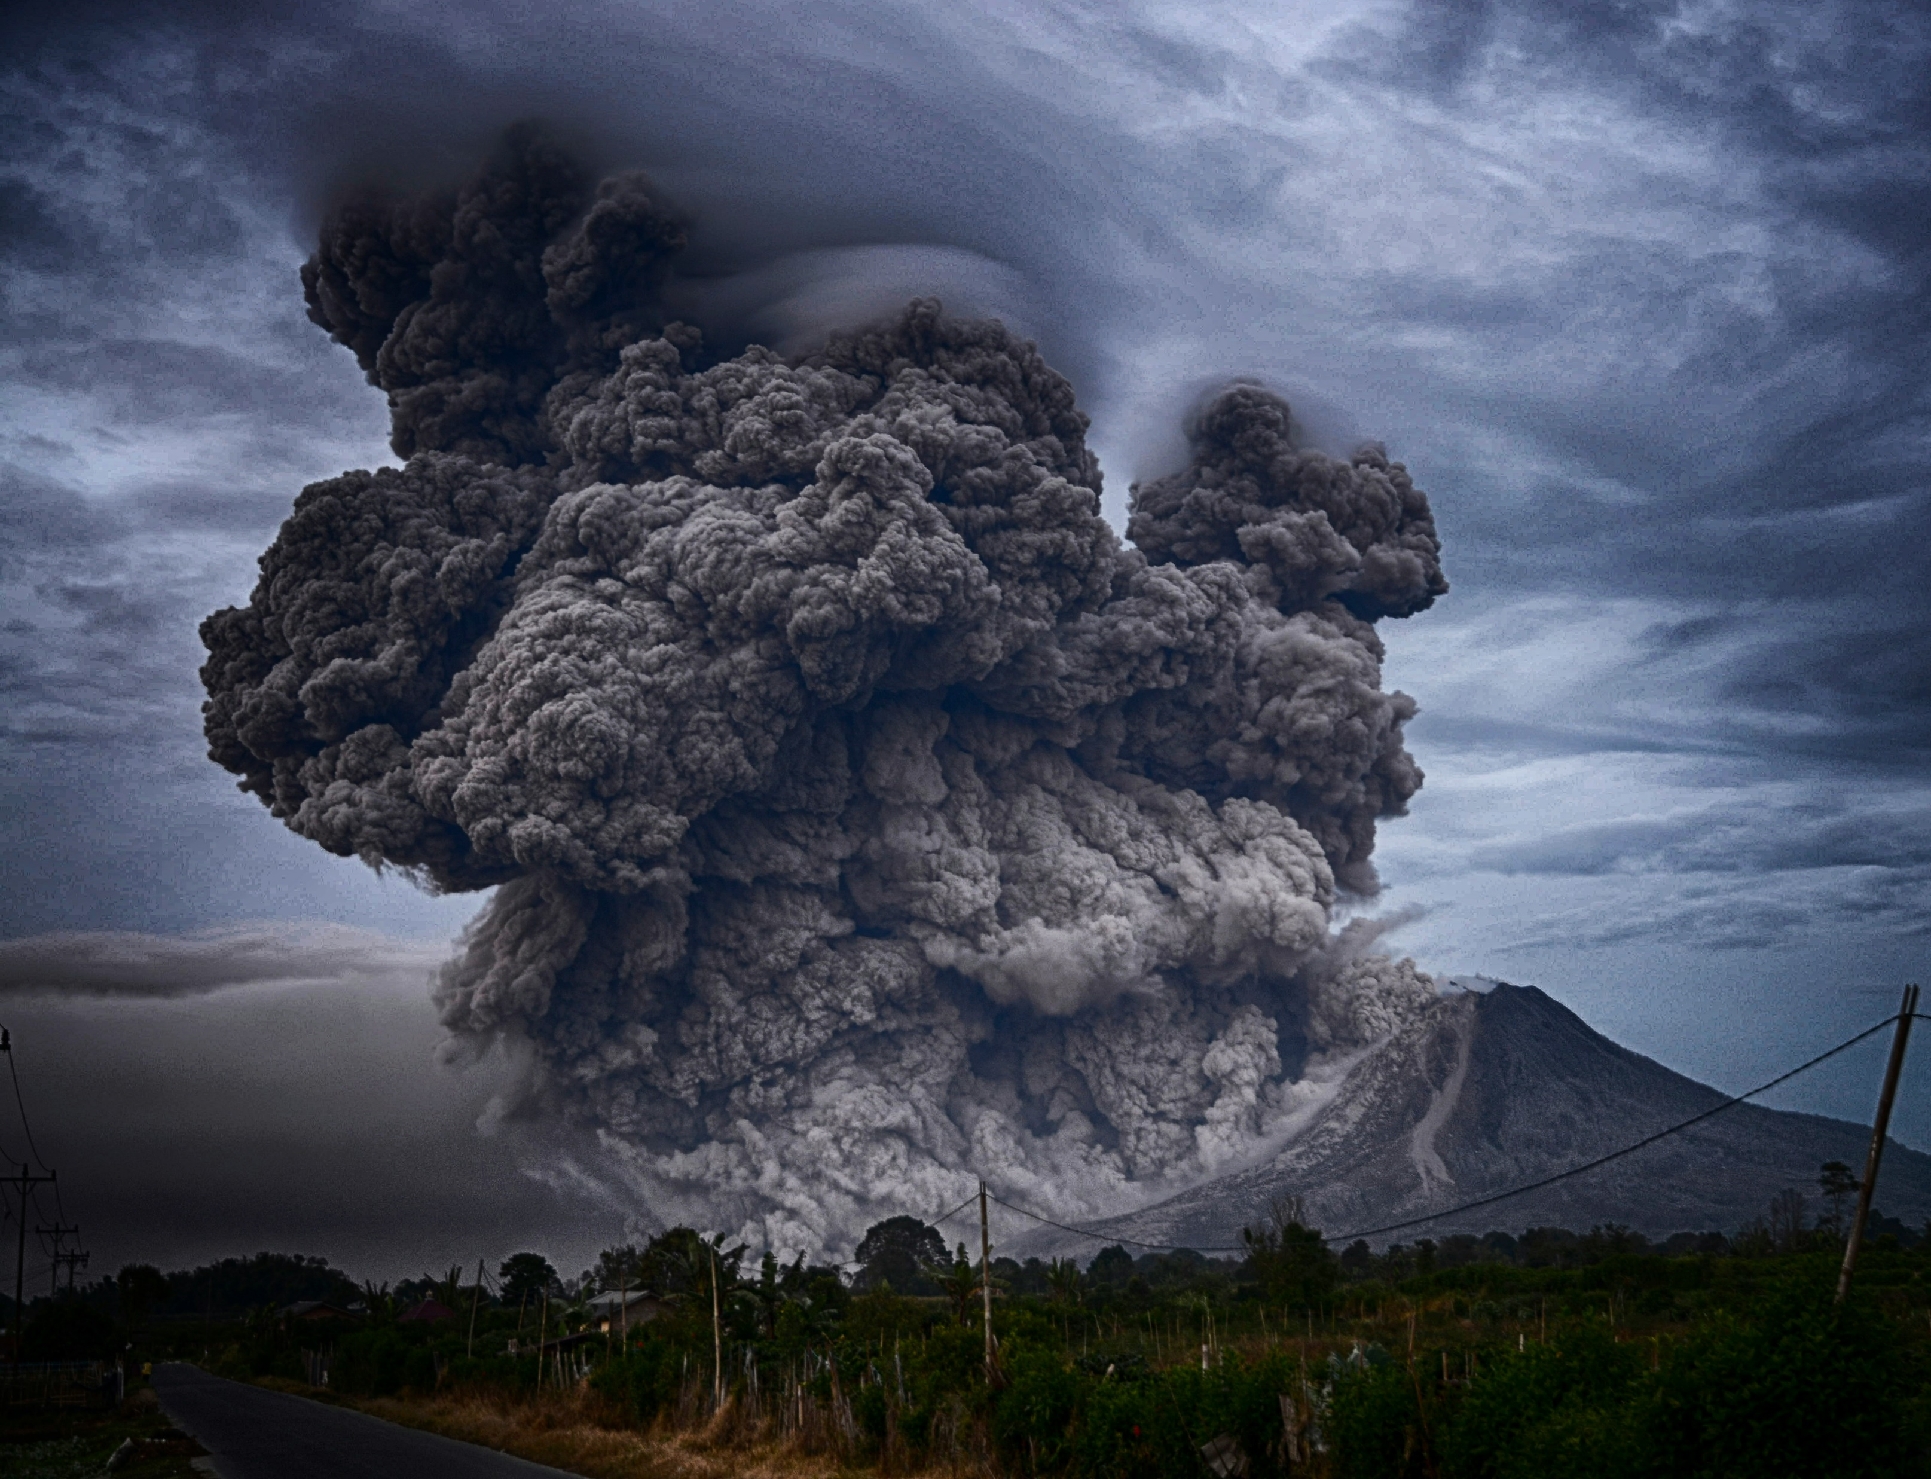
6.轉彎
Notes:
https://unsplash.com/photos/volcano-eruption-during-daytime-qexZLgMcbPc

Slide 7

7.結局
Notes:
https://unsplash.com/photos/woman-holding-red-phone-m7zKB91brGo

